Slide 1
REC-0: Welcome to 449!
CS0449: Intro to System Software
Shinwoo Kim
shinwookim@pitt.edu
https://sites.pitt.edu/~shk148/
Spring 2023, Term 2234
Friday 12 PM Recitation
Jan 20th, 2023
Slides adapted from
Martha Dixon and Vinicius Petrucci
Department of Computer Science
School of Computing & Information
University of Pittsburgh
Introduction
Understanding the command-line
Accessing the Thoth machine
Your first C program!
Debugging with GDB

Slide 2
TA Introduction
Shinwoo Kim
Second-year student in CS
TA for
CS 0449: Introduction to System Software (this course)
CS 0441: Discrete Structures for Computer Science
shinwookim@pitt.edu (preface subject line with [CS 0449])
Faster responses on discord: shinwookim#1088
Recitation Materials: https://sites.pitt.edu/~shk148/teaching/CS0449-2234/

Slide 3
TA Office Hours
Day | Time/Location
Monday | 1:00 PM - 2:30 PM @ 5806 SENSQ
Tuesday | 3:00PM - 3:45PM @ 5712 SENSQ
Wednesday | 2:30PM @ 5710 SENSQ
Thursday | 1:00PM - 3:45PM @ 6408 SENSQ
Friday | 11:00AM - 12:00PM @ 5806 SENSQ
By appointment | Message me to schedule a meeting (in-person/virtual)
Changes to office hours will be announced on discord

Slide 4
Lab 0 – Hello Lab: Setting up to environment
Goals
Set up Computing Environment
Accessing Thoth
Getting familiar with the Shell
Learn to compile and run C code on Linux
Learn to debug C programs using GDB

Slide 5
Accessing Thoth
You will be using the CS department’s Thoth machine for your labs/projects/assignments
This ensures that everyone’s code is compiled and run in the same way
Your code must work on Thoth to receive full marks!
To access the Thoth server, we need to use ssh (secure shell) to connect.
What Operating System are you running?
Microsoft Windows
PuTTY (external program)
PowerShell
macOS/Linux/BSD or any other Unix-like OS
Terminal
Bash via WSL
(Windows Subsystem for Linux)
Using ssh

Slide 6
Accessing Thoth (cont.)
Open Terminal/Command-line
ssh <PittID>@thoth.cs.pitt.edu
Then use your Pitt university computing account password (my.pitt.edu)
If you are on windows, use PowerShell, or download PuTTY
https://www.chiark.greenend.org.uk/~sgtatham/putty/
Alternatively, you can enable WSL (Windows Subsystem for Linux), then use Bash
wsl --install
Install Ubuntu from Windows Store

Slide 7
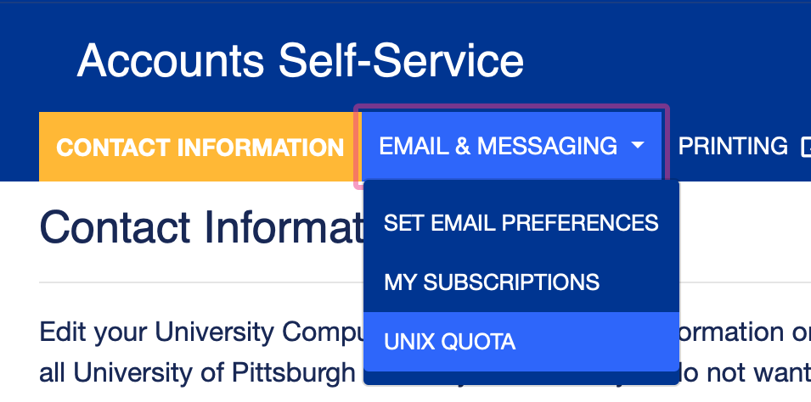
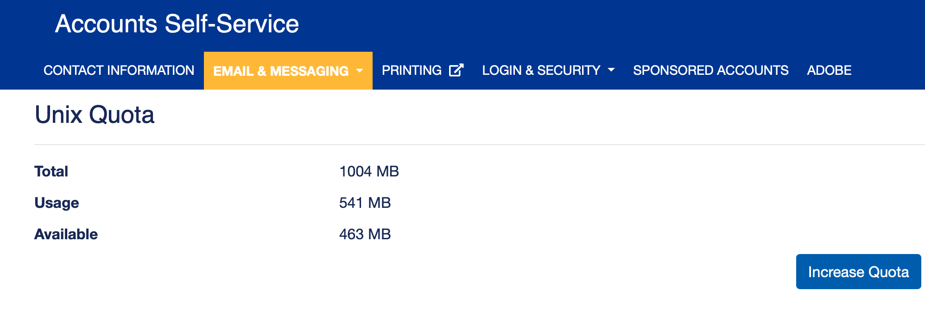
Increasing AFS Space
Once you can connect, you should increase your AFS space to ensure you have enough storage space to run the assignments
Login to https://accounts.pitt.edu
“Email & Messaging”
“Unix Quota”
“Increase Quota”

Slide 8
Linux Shell: Running Commands
The shell is just a different interface to your computer!
Old, but useful
Just like using a keyboard + mouse
Useful for automating tasks (especially if we don’t need a graphical environment)
Useful for interacting with remote computers
Like Thoth!

Slide 9
Basic Shell Commands
/ (forward slash) is used as path separator
Directory Shortcuts
/ | Root directory
. | Current directory
.. | Parent directory (one above)
~ | Home directory
pwd prints the working directory
man <command> displays the manual for a command

Slide 10
Editing Text
Thoth has several text editors installed
Nano (basic, easiest to use)
Vim (popular, steep learning curve)
Emacs (popular, steep learning curve, heavily customizable)
We can also use GUI text editors such as
Atom, VS Code, Notepad ++, others
But we will use the native text editors for today’s lab

Slide 11
Creating a C Program
#include <stdio.h>
int main (int argc, char* argv[]) {
//Declare a variable
int x;
//Assign a variable
x = 2;
//Print a string and a variable
printf(“Hello world! x is currently %d \n”, x);
return 0;
}

Slide 12
C Programs
Creating a C Program
#include <stdio.h>
int main (int argc, char* argv[]) {
//Declare a variable
int x;
//Assign a variable
x = 2;
//Print a string and a variable
printf(“Hello world! x is currently %d \n”, x);
return 0;
}
Preprocessor command: tells compiler to include contents of the standard input and output file

Slide 13
C Programs
Creating a C Program
#include <stdio.h>
int main (int argc, char* argv[]) {
//Declare a variable
int x;
//Assign a variable
x = 2;
//Print a string and a variable
printf(“Hello world! x is currently %d \n”, x);
return 0;
}
Standard input/output file: Contains functions like scanf() (take input) and printf() (display output)

Slide 14
C Programs
Creating a C Program
#include <stdio.h>
int main (int argc, char* argv[]) {
//Declare a variable
int x;
//Assign a variable
x = 2;
//Print a string and a variable
printf(“Hello world! x is currently %d \n”, x);
return 0;
}
Execution of C files starts from main()

Slide 15
C Programs
Creating a C Program
#include <stdio.h>
int main (int argc, char* argv[]) {
//Declare a variable
int x;
//Assign a variable
x = 2;
//Print a string and a variable
printf(“Hello world! x is currently %d \n”, x);
return 0;
}
Placeholders:
%d int
%u unsigned int
%f float
%s “string”
%x hexadecimal
%p pointer
Using printf() without using #include <stdio.h> results in compilation error
printf(): library function to send formatted output to screen

Slide 16
C Programs
Creating a C Program
#include <stdio.h>
int main (int argc, char* argv[]) {
//Declare a variable
int x;
//Assign a variable
x = 2;
//Print a string and a variable
printf(“Hello world! x is currently %d \n”, x);
return 0;
}
Exit status: Returning 0 basically means we exit without error

Slide 17
Moving files to and from Thoth
To move files in-and-out of Thoth, we can use Secure Copy (SCP)
To copy local.txt to Thoth (saved as remote.txt in home directory of Thoth)
scp local.txt user@thoth.cs.pitt.edu:remote.txt
To copy remote.txt from Thoth (saved as local.txt on your device)
scp user@thoth.cs.pitt.edu:remote.txt local.txt
Check the contents of main.c
cat main.c
We can make adjustments using nano
nano main.

Slide 18
Compiling and Running C Programs
-W: sets warnings
-Wall: enable all warnings
-g: turns on debugging symbols
-o: used for renaming executable
What you want the executable to be named
Compile using GCC (Gnu Compiler Collection)
gcc –Wall –g –std=c99 –o hello main.c
At last, we can run our Hello World program
./hello
Source filename
-std: sets what version of C is being used
-std=c99: use C99
Run the executable
Executable File
Source File
Compiler
hello.c
a.out
Program Running
$ gcc hello.c
$ ./a.out
To compile
To run

Slide 19
Lab 0A Submission
Rename main.c to username_lab0.c
mv main.c shk148_lab0.c
mv command is also used for moving files
Copy username_lab0.c to Dr. Oliveira’s folder
cp shk148_lab0.c /afs/pitt.edu/home/l/u/lun8/public/lab0/submissions
To ensure your lab was submitted, run:
/afs/pitt.edu/home/l/u/lun8/public/lab0/materials/check_submission.sh shk148

Slide 20
Part B – Debugging using GDB
In later labs, we will use GDB (GNU Project debugger), to debug programs
Today, we will get use to using GDB by running it on a demo program
wget https://cs0449.gitlab.io/sp2023/labs/00/calculator.c -O calculator.c
gcc -Wall -g -std=c99 -o calculator calculator.c
./calculator 4 5 +
Run GDB
Gdb calculator
Notice we are running GDB with our executable (not the source .c file)
Run 4 5 +

Slide 21
GDB Tutorial
Run through the GDB tutorial (part B)
https://cs0449.gitlab.io/sp2023/labs/00/
Start from B.5.
Once you’ve finished Part B, you are done for today!

